Slide 1
Term 3 Week 6 Lesson 4
Reactions of acids

Slide 2
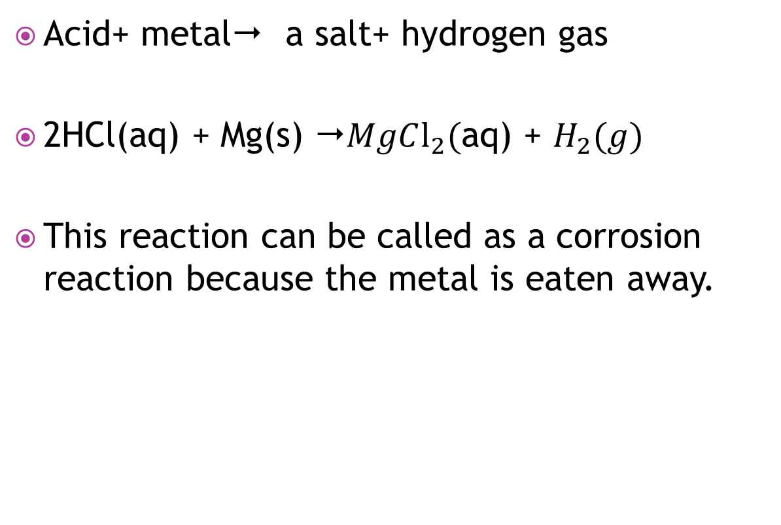
Reactions between acid and a metal
Acid+ metal a salt+ hydrogen gas
2HCl(aq) + Mg(s) $MgCl_{2}($aq) + $H_{2}(g)$
This reaction can be called as a corrosion reaction because the metal is eaten away.

Slide 3
Reaction between an acid and a carbonate or hydrogen carbonate
Acid + carbonate  a salt + carbon dioxide + water
2 HCl(aq) + CaCO3(s)  CaCl2 (aq) + H2O (l) + CO2(g)
Acid+ hydrogen carbonate  a salt+ carbon dioxide + water
HCl(aq) + NaHCO3(s) NaCl(aq) + H2O (l) + CO2(g)

